Slide 1
Structured Design
Lecturer: Ngo Huy Bien
Software Engineering Department
Faculty of Information Technology
VNUHCM - University of Science
Ho Chi Minh City, Vietnam
nhbien@fit.hcmus.edu.vn

Slide 2

Objectives
To design software systematically.

Slide 3

Contents
OO Design Methodology.
Designing with Patterns.
Design and Programming Relationship.

Slide 4

References
Meilir Page-Jones (1988). The Practical Guide to Structured Systems Design. Pearson Education.
David Budgen (2003). Software Design. Pearson.
Robert C. Martin (2017). Clean Architecture - A Craftsman's Guide to Software Structure and Design. Pearson Education.
Glenford J. Myers (1975). Reliable Software Through Composite Design. Petrocelli‐Charter.

Slide 5

Key Ideas
Notations
Steps
Templates

Slide 6
What is Structured Design? [1]
Structured Design is a disciplined approach to computer system design. It has the following five aspects:
Structured Design uses a definition of the problem to guide the definition of the solution.
Structured Design seeks to conquer the complexity of large systems by means of partitioning the system into "black boxes" and by organizing the black boxes into hierarchies suitable for computer implementation.
Structured Design uses tools, especially graphic ones, to render systems readily understandable.
Structured Design offers a set of strategies for developing a design solution from a well-defined statement of a problem.
Structured Design offers a set of criteria for evaluating the quality of a given design solution with respect to the problem to be solved.

Slide 7
The Context of Design
Design is the bridge between analysis and implementation.
Broadly, the "Seven Ages" of a classical computer system are
problem or opportunity recognition,
feasibility study,
analysis,
design
preliminary design
detailed design
implementation,
testing, and
maintenance.

Slide 8
1. Problem or Opportunity Recognition
The idea of developing a new system occurs to the user when he recognizes that he has a problem in the way that he currently carries out his business or when he identifies an opportunity to improve his business.

Slide 9
2. Feasibility Study
Maybe the user does need a computer – but maybe not.
That's one of the decisions that cannot be made before completion of the next stage of design: the feasibility study (alias survey).
The feasibility study serves
to identify the scope of the current system to be studied;
to identify problems and unexploited opportunities in the current system, which may be either manual or automated;
to identify major objectives for the new system;
to estimate roughly the costs of each possible solution to the user's problems
For most projects, the feasibility study will take less than a month.

Slide 10
3. Analysis
The information gathered during the feasibility study, although probably not very detailed – or even accurate – will be the jumping-off point for a full analysis.
Analysis (alias external design, business systems analysis, or specification phase) consists of grilling the users about what the current system does, what extra features they want in their new system, and what constraints (such as response time) the new system must satisfy.
Analysis must produce a specification. This document states the functional and data requirements for the new system.

Slide 11
4. Design
This involves writing systems flowcharts, job steps, program narratives, and so on, which is known as preliminary design.
Preliminary design is followed by detailed design, during which time program flowcharts, file layouts, and data descriptions – everything but code – are developed.
Structured Design, which follows Structured Analysis, takes the structured specification together with its definition of physical configuration and consolidates preliminary and detailed design into a single design phase with a well-defined set of design activities and an objective set of criteria for design quality.

Slide 12
5. Implementation
In the implementation phase (alias programming or coding), what was produced during design is turned into code.

Slide 13
6. Testing
The testing phase has traditionally involved first the testing of separate parts of the system and then the testing of the system as a whole.
The whole system is then turned over for acceptance testing (alias quality assurance).
Structured techniques emphasize the interweaving of the testing phase as much as possible with implementation so that system quality is built in rather than in some mysterious way "added in" after the fact.
Indeed, the development of test cases and a test plan can begin at the end of analysis and be carried out during the design phase itself. This will ensure that testing is ready to begin as soon as implementation is.

Slide 14
7. Maintenance
Once the system has been coaxed into passing the acceptance test, it is ready for delivery (alias cutover, production inception, parallel operation, and so on).
Anything that happens to the system from then on is called maintenance.
A few years after the delivery of a traditional system, changes during maintenance become extremely tedious, error-prone, and expensive.
Ideally, management recognizes the problem and does a feasibility study on replacing the old system with a new one.
Thus, the cycle begins anew.

Slide 15


Slide 16
The Structured Specifications
The Data Flow Diagram
The Data Dictionary
Entity-Relationship Diagrams
Tools To Express Policy
Structured English
Decision trees
Decision tables

Slide 17
Configuring the System
The final step of analysis is the creation of a configuration for the essential model of the new system.
Composite Data
Data Elements
Data Flows
Processes
Data Stores
External Entities

Slide 18
Design Strategies
Transactional Analysis.
Transform Analysis.
Identify the Central Transform.
Produce a First-Cut Structure Chart.
Revise the First-Cut Structure Chart.

Slide 19


Slide 20
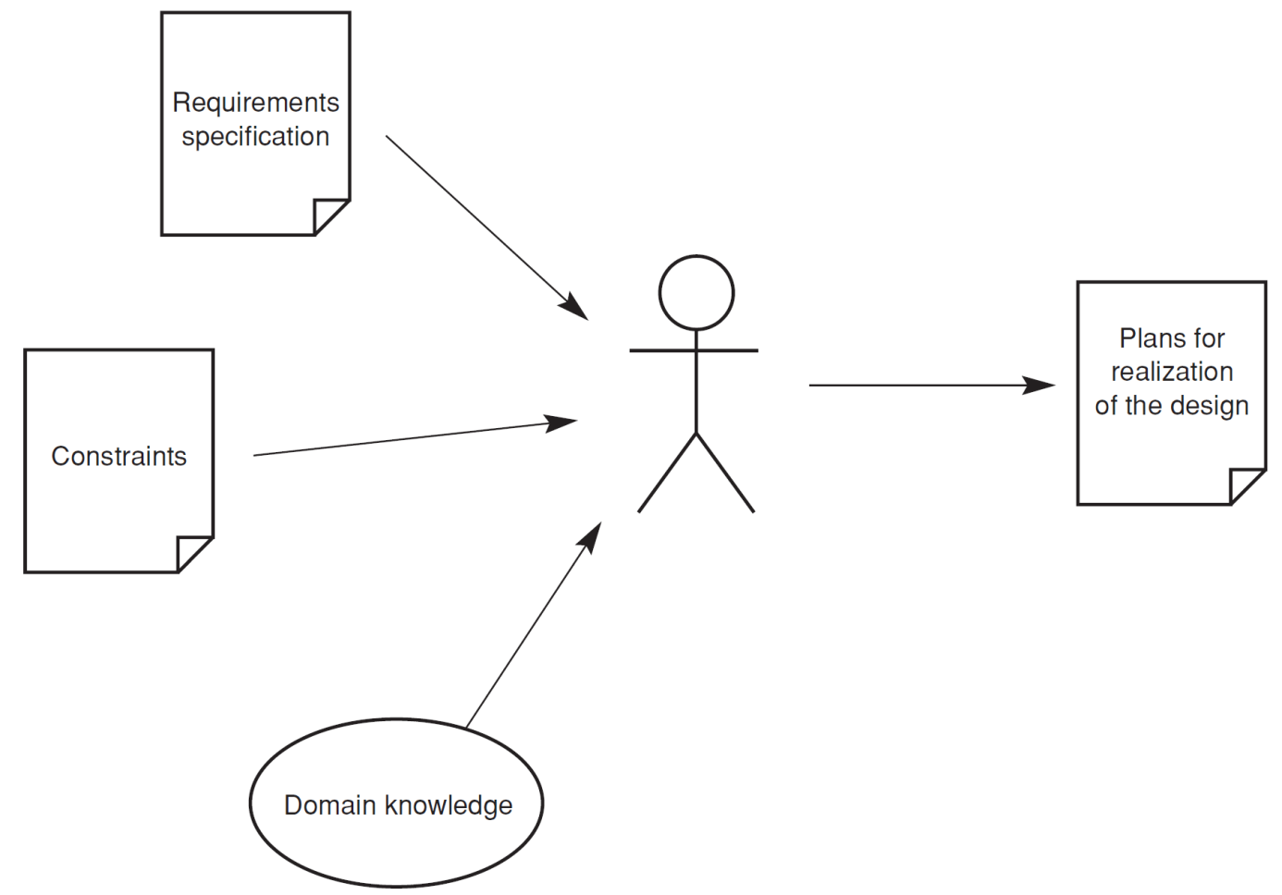
The Designer's Channels of Communication [2]

Slide 21
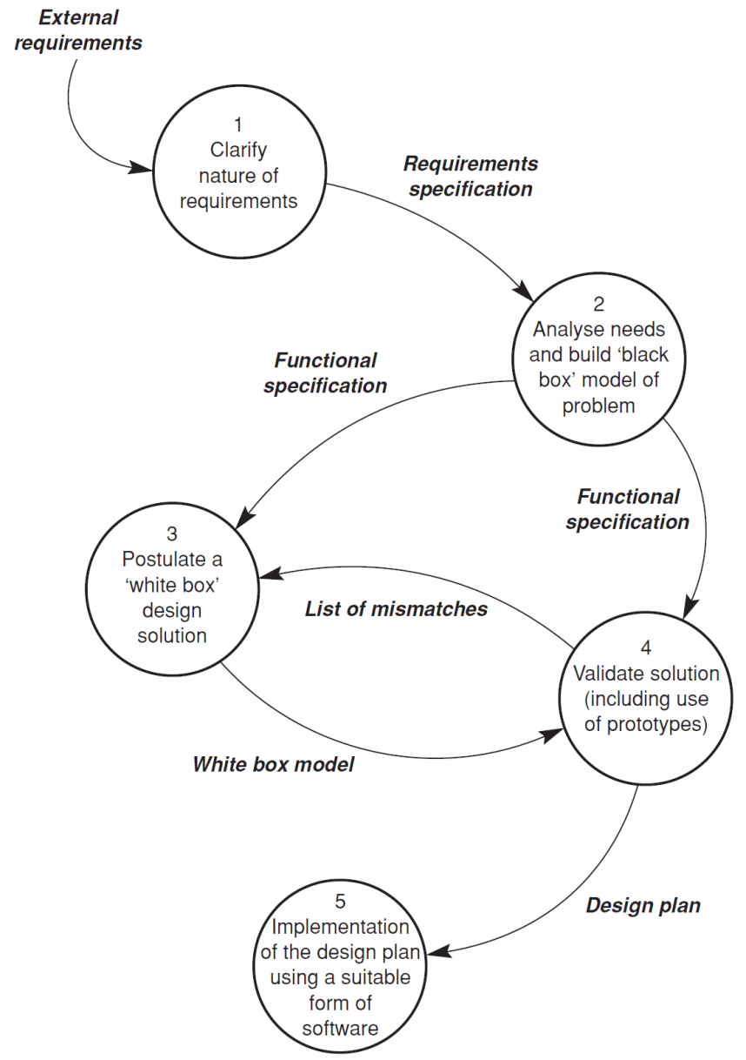
A Model of the Design Process

Slide 22
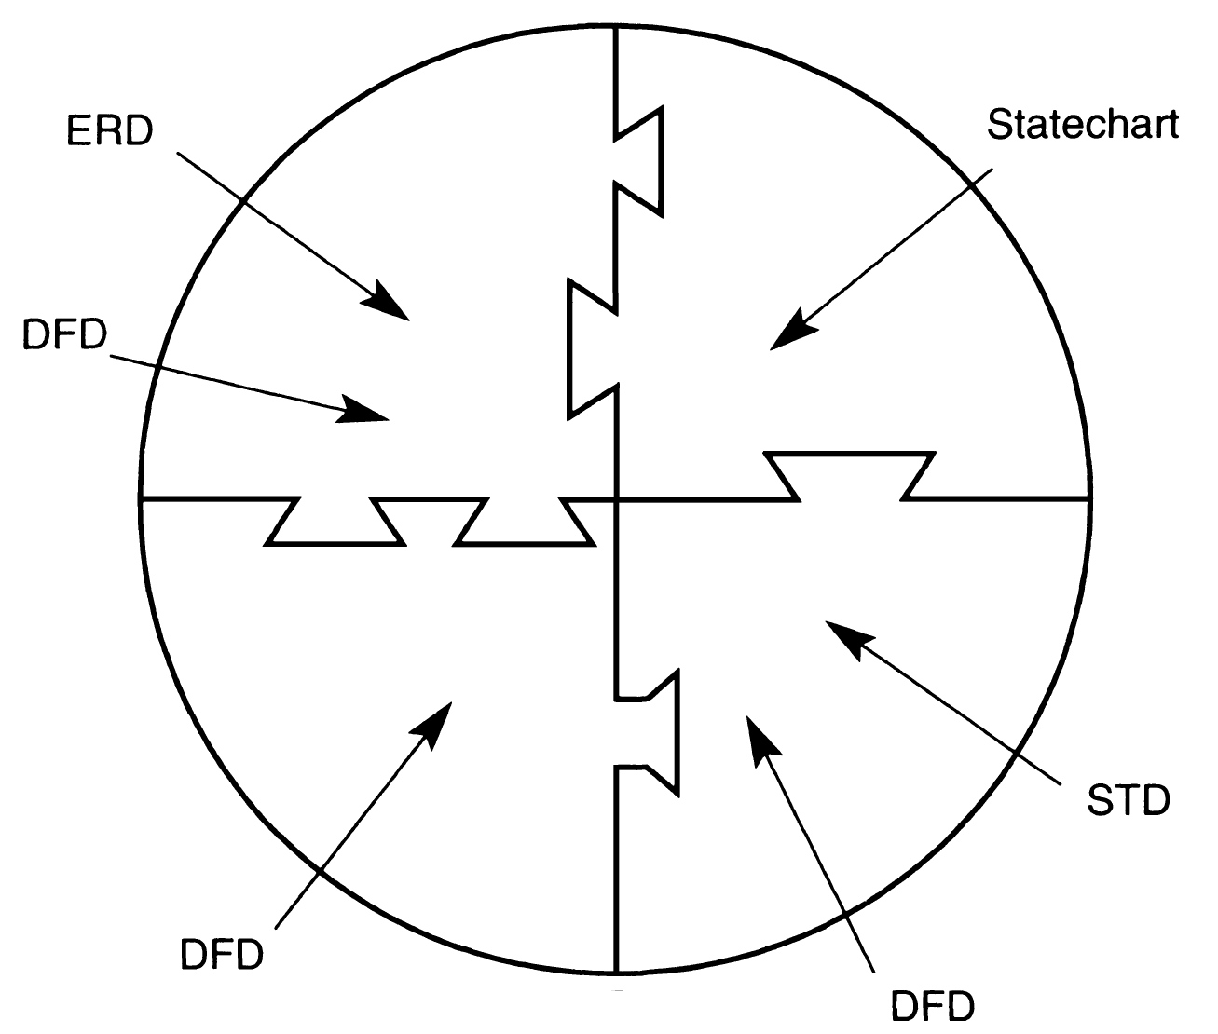
Design by Composition
The relevant entities are normally identified by analyzing an initial description of the problem.
A complete and detailed model of the solution is then developed by elaborating the descriptions of the entities and the interactions occurring between them.

Slide 23
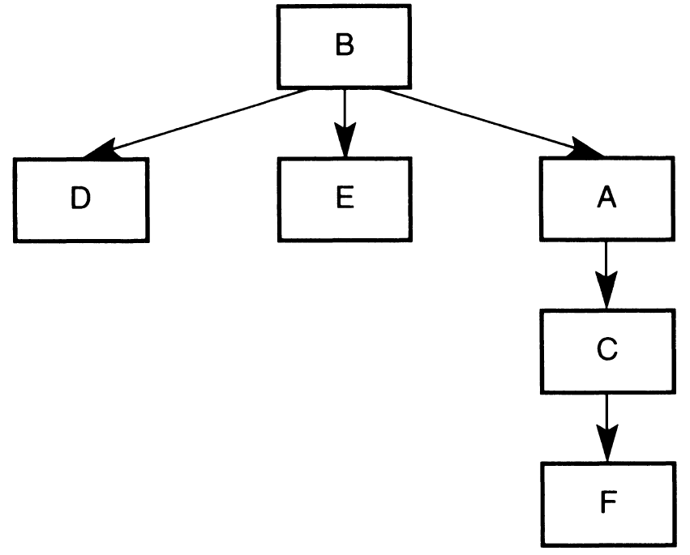
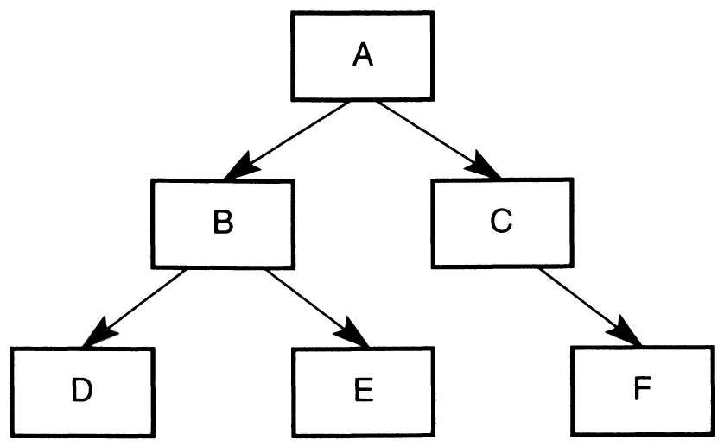
Top-Down Decomposition
Stepwise refinement
Divide and conquer
This approach is unstable. It may be that these two structures will converge following further decomposition, but this cannot be guaranteed by the use of the strategy alone.

Slide 24
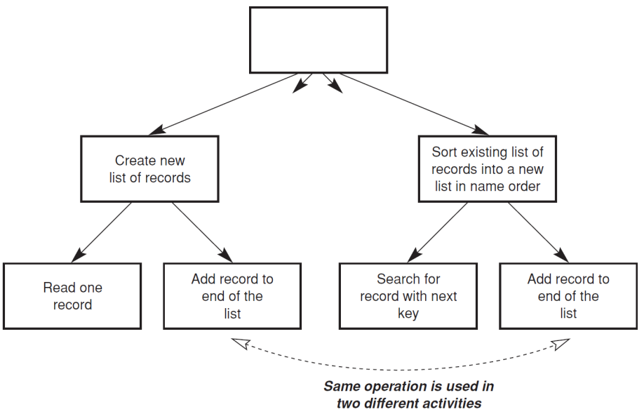
Top-Down Decomposition Limitations
Wicked problem
The lack of a 'stopping rule' that the designer can use to determine that the design process is complete.
There are no generally applicable criteria that can be used to determine how small a task should be to be considered as suitably elemental.
The problem of duplication.

Slide 26
Programming Paradigms [3]
Paradigms are ways of programming, relatively unrelated to languages.
A paradigm tells you which programming structures to use, and when to use them.
Structured programming imposes discipline on direct transfer of control.
Object-oriented programming imposes discipline on indirect transfer of control.
Functional programming imposes discipline upon assignment.
Those three align with the three big concerns of architecture: function, separation of components, and data management.
Programming approaches → Analysis & Design approaches.

Slide 27
Structured Programming
Dijkstra discovered that certain uses of goto statements prevent modules from being decomposed recursively into smaller and smaller units, thereby preventing use of the divide-and-conquer approach.
He replaced those jumps with the more familiar if/then/else and do/while/until constructs.

Slide 28
Structured Programming & Design
Structured programming allows modules to be recursively decomposed into provable units, which in turn means that modules can be functionally decomposed.
That is, you can take a large-scale problem statement and decompose it into high-level functions.
Each of those functions can then be decomposed into lower-level functions, ad infinitum.
Moreover, each of those decomposed functions can be represented using the restricted control structures of structured programming.

Slide 30
Evaluating a Design Solution [1]
"Hey, Arthur, what do you think of my program?"
"I wouldn't have done it that way."
"Why not?"
"It stinks."
"What do you mean, it …"
"Why on earth did you design it like that, anyway?"

Slide 31
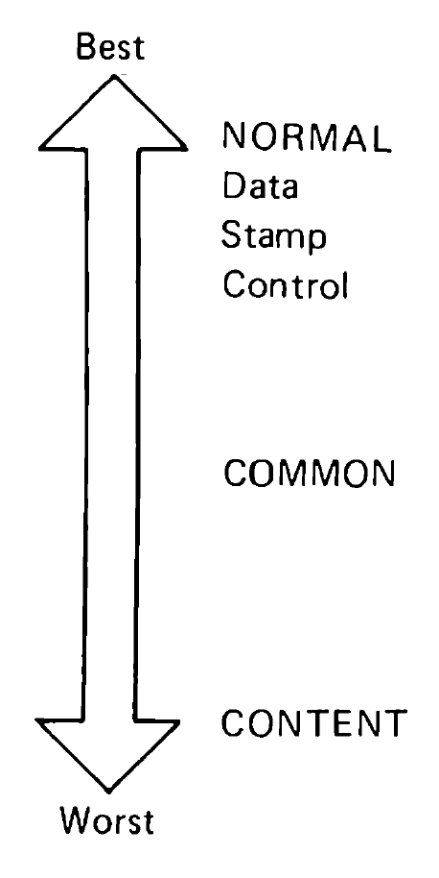
Coupling
Coupling is the measure of the interdependence between two modules.
In a good design, coupling is kept to a minimum by:
eliminating unnecessary relationships between modules;
reducing the number of necessary relationships; and
easing the tightness of necessary relationships.

Slide 32
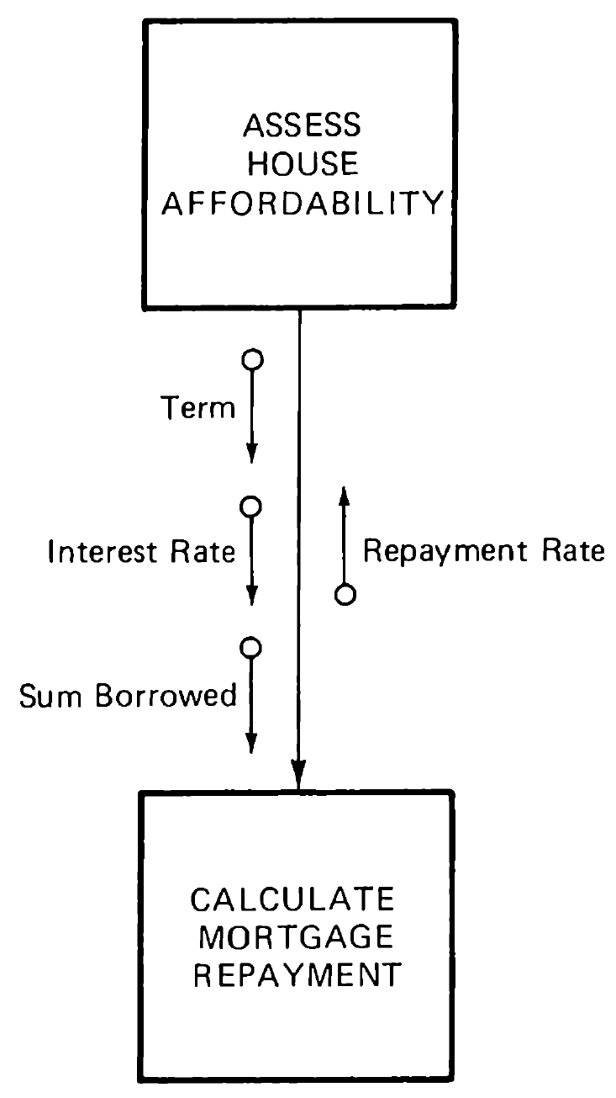
Data Coupling
Two modules are data coupled if they communicate by parameters, each parameter being an elementary piece of data.

Slide 33
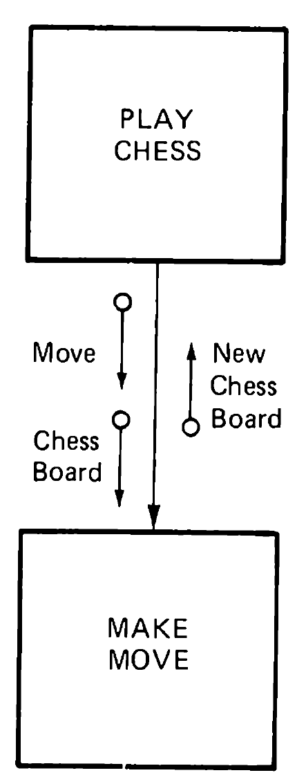
Stamp Coupling
Two normally coupled modules are stamp coupled if one passes to the other a composite piece of data, that is, a piece of data with meaningful internal structure.

Slide 34
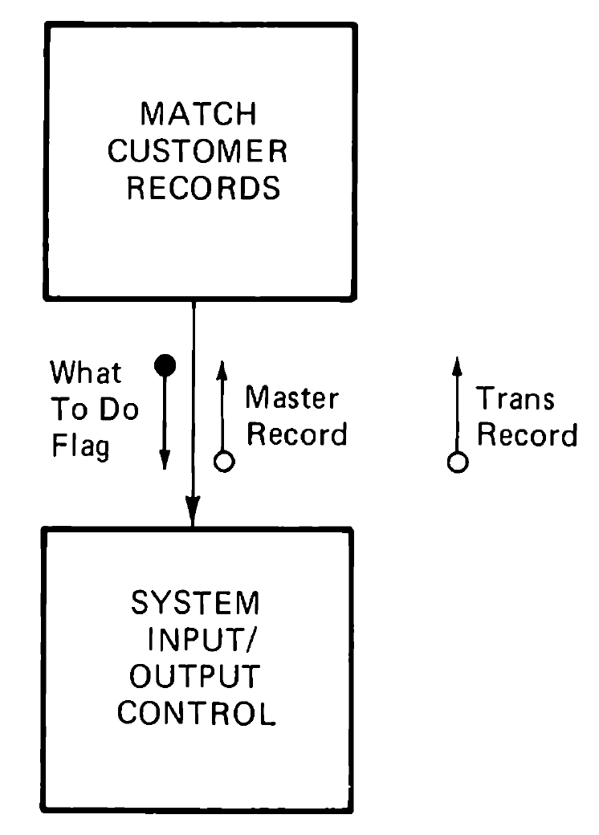
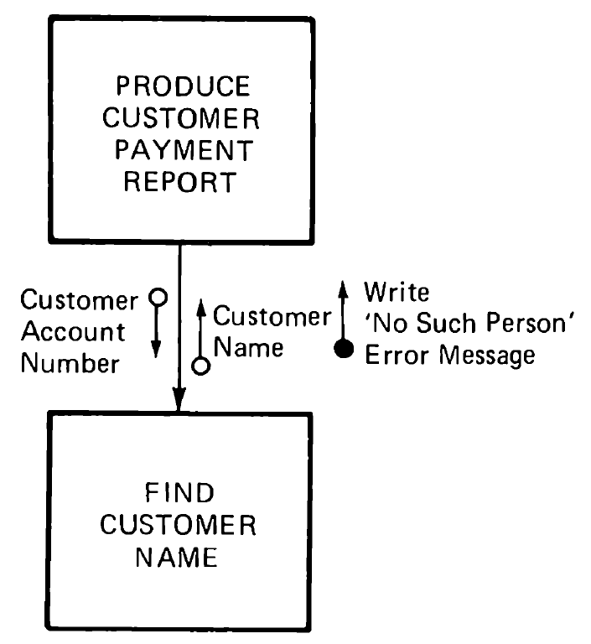
Control Coupling
Two modules are control coupled if one passes to the other a piece of information intended to control the internal logic of the other.

Slide 35
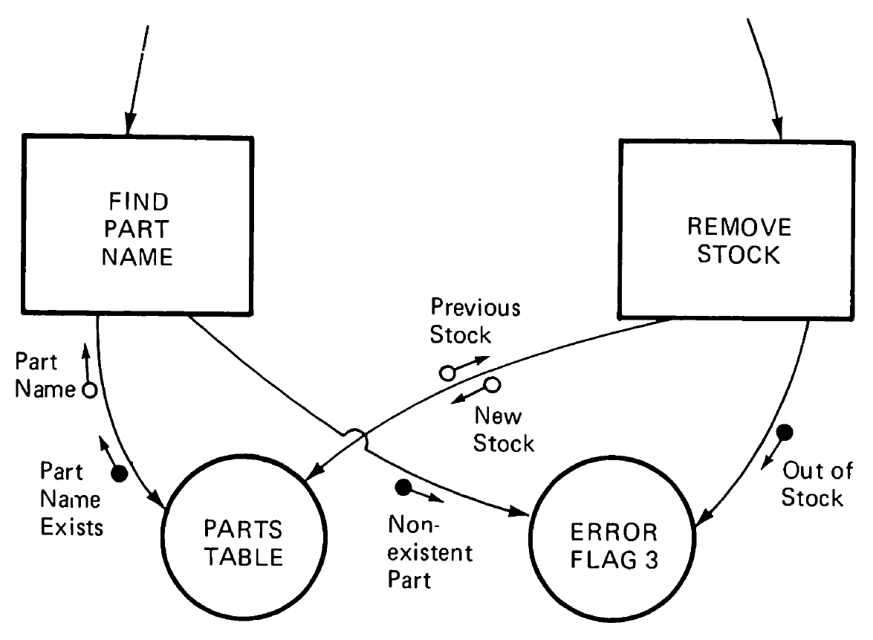
Common (Alias Global) Coupling
Two modules are common coupled if they refer to the same global data area.

Slide 36
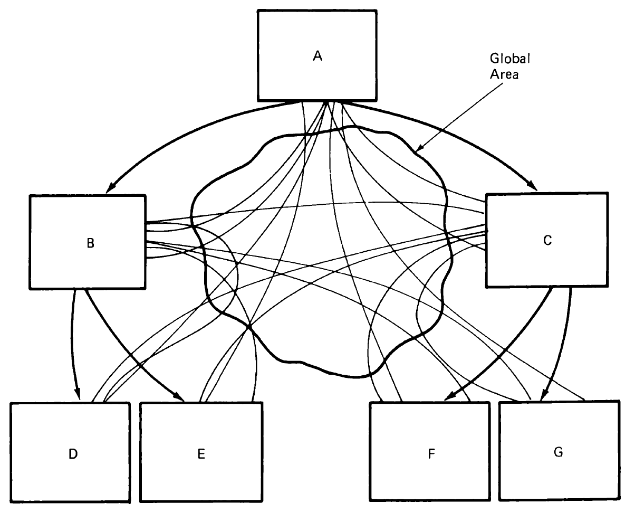
Common Coupling: Brain Teaser
Brain Teaser: Who's joined to whom-and by what?

Slide 37
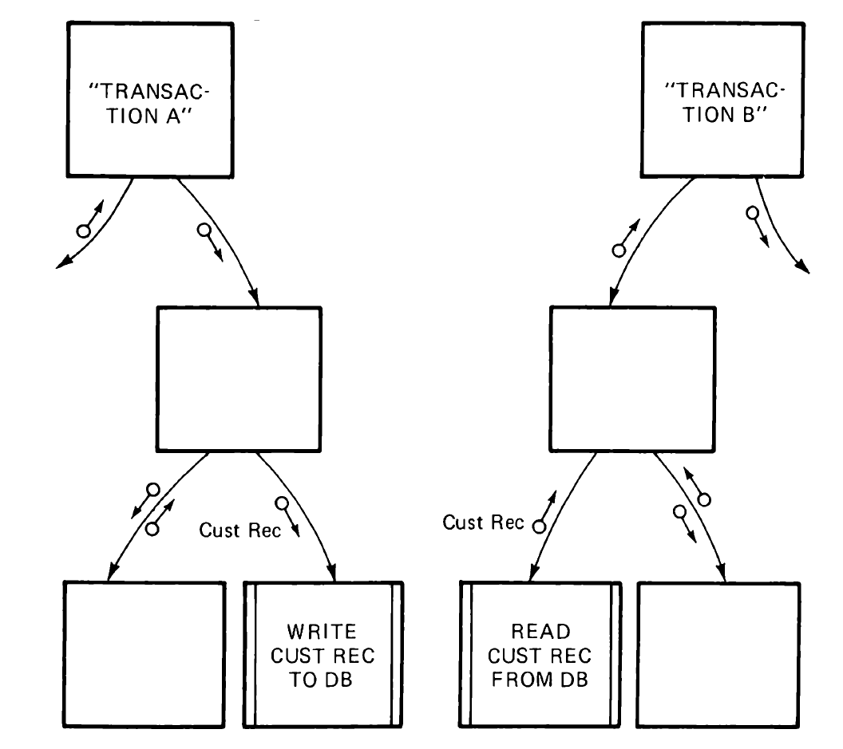
Database Coupling
Database coupling also differs from common coupling in three significant ways.
Databases are nonvolatile. Their contents can be inspected for correctness by, for instance, database auditing software.
Databases are (or should be!) designed with consummate discipline. They are not arbitrary areas of data but contain well-defined, application-oriented objects with specific integrity rules.
A given transaction does not randomly attract large areas of the database. It creates, deletes, modifies, or reads only the specific objects that it needs in order to carry out its function.

Slide 38
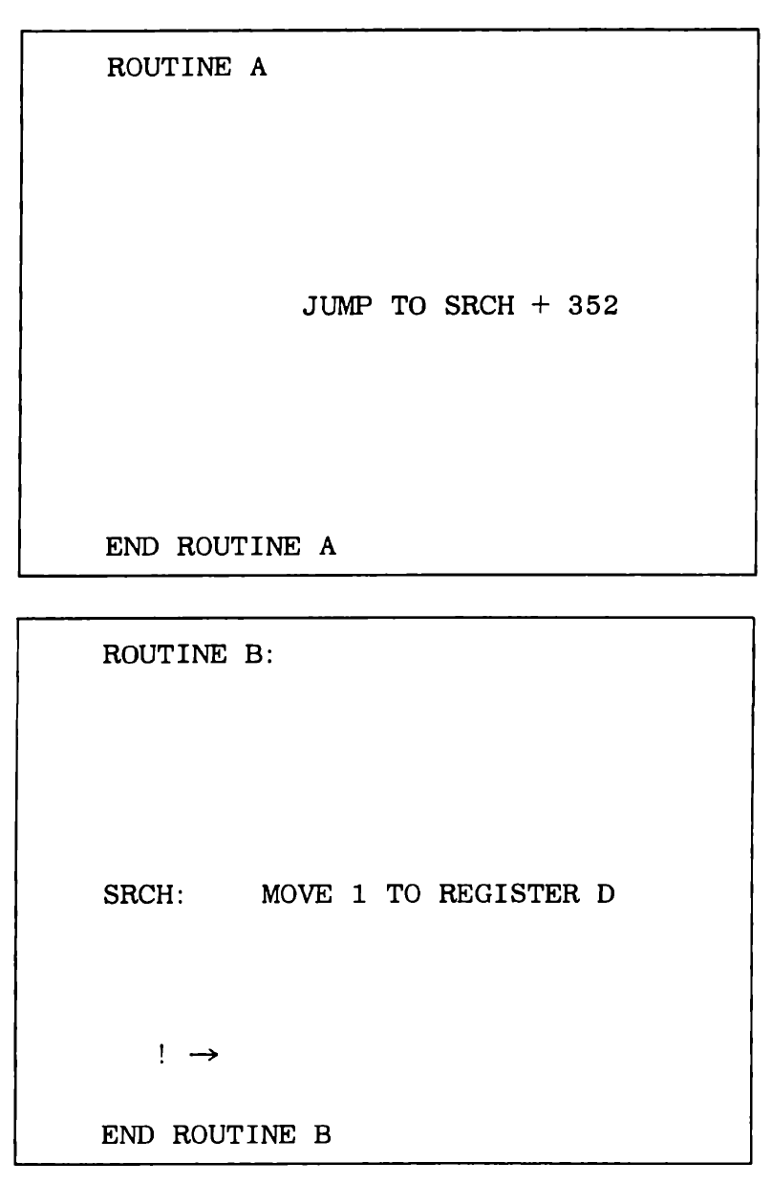
Content (Alias Pathological) Coupling
Two modules exhibit content coupling if one refers to the inside of the other in any way-for instance,
if one module branches or falls through into another,
if one module refers to (or changes) data within another, or
if one module alters a statement in another.

Slide 40
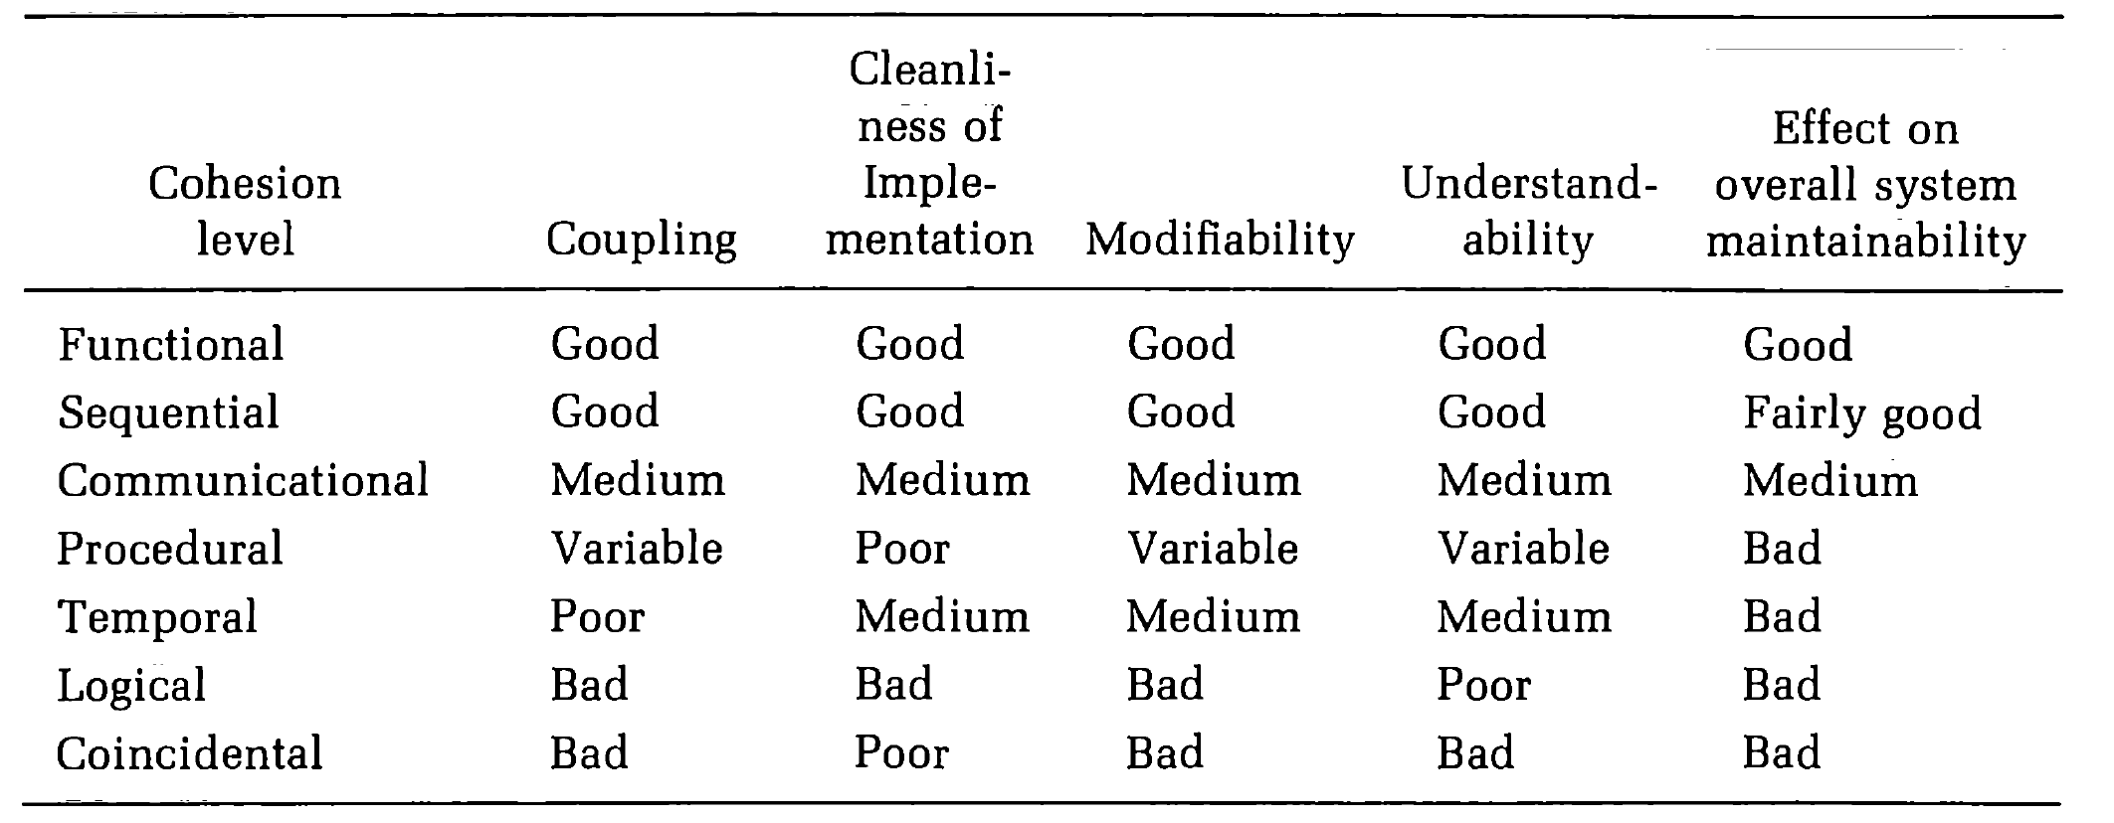
Cohesion
Cohesion is the measure of the functional relatedness of elements (instructions, data definitions, etc.) within a single module.
In a good design, the cohesion of every module is high.
A module may exhibit any of seven levels of cohesion depending on how the activities within the module are related.

Slide 41
Functional Cohesion
A functionally cohesive module contains elements that all contribute to the execution of one and only one problem-related task.
Each of these modules has a strong, single-minded purpose.
When its boss calls it, it carries out just one job to completion without getting involved in any extracurricular activity.
COMPUTE COSINE OF ANGLE
VERIFY ALPHABETIC SYNTAX
READ TRANSACTION RECORD
DETERMINE CUSTOMER MORTGAGE REPAYMENT
COMPUTE POINT OF IMP ACT OF MISSILE
CALCULATE NET EMPLOYEE SALARY
ASSIGN SEAT TO AIRLINE CUSTOMER

Slide 42
Sequential Cohesion
A sequentially cohesive module is one whose elements are involved in activities such that output data from one activity serves as input data to the next.
This group of four activities cannot be summed up as a single function, which means the "module" is not functionally cohesive.
If we added a fifth step, PUT ON FINAL COAT, we would have a functionally cohesive module called REPAINT CAR.
1. CLEAN CAR BODY
2. FILL IN HOLES IN CAR
3. SAND CAR BODY
4. APPLY PRIMER

Slide 43
Communicational Cohesion
A communicationally cohesive module is one whose elements contribute to activities that use the same input or output data.
These four activities are related because they all work on the same input data, the book, which makes the "module" communicationally cohesive.
1. FIND TITLE OF BOOK
2. FIND PRICE OF BOOK
3. FIND PUBLISHER OF BOOK
4. FIND AUTHOR OF BOOK

Slide 44
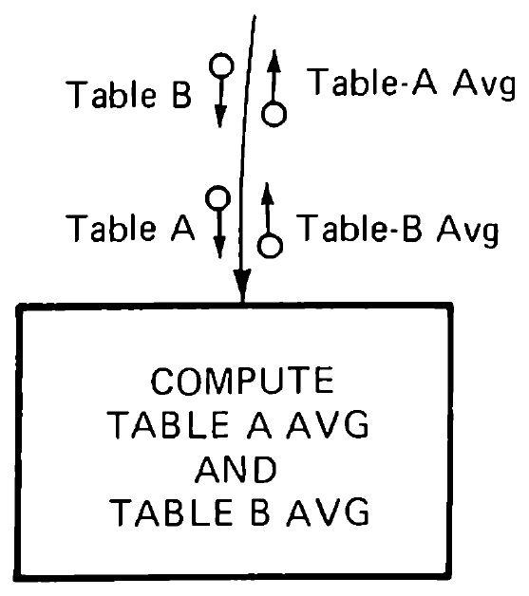
Procedural Cohesion
A procedurally cohesive module is one whose elements are involved in different and possibly unrelated activities in which control flows from each activity to the next. They are related by order of execution rather than by any single problem-related function.
A procedurally cohesive module that averages two completely unrelated tables, TABLE-A and TABLE-B, which both just happen to have 100 elements each.
module compute table-A-avg and table-B-avg
uses table-A, table-B
returns table-A-avg, table-B-avg
table-A-total : = 0
table-B-total : = 0
for i = i to 100
add table-A (i) to table-A-total
add table-B (i) to table-B-total
endfor
table-A-avg : = table-A-total/100
table-B-avg : = table-B-total/100
endmodule

Slide 45
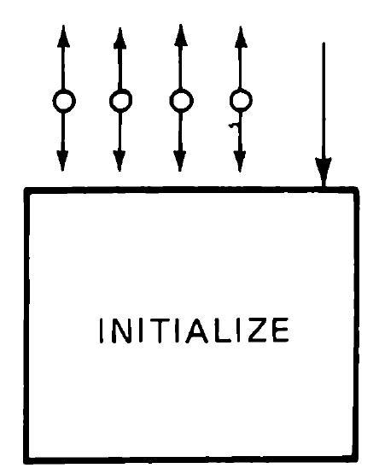
Temporal Cohesion
A temporally cohesive module is one whose elements are involved in activities that are related in time.
module initialize
updates a-counter, b-counter, items table,
totals table, switch-a, switch-b
rewind tape-a
set a-counter to 0
rewind tape-b
set b-counter to 0
clear items table
clear totals table
set switch-a to off
set switch-b to on
endmodule

Slide 46
Logical Cohesion
A logically cohesive module is one whose elements contribute to activities of the same general category in which the activity or activities to be executed are selected from outside the module.
A logically cohesive module contains a number of activities of the same general kind.
To use the module, we pick out just the piece(s) we need.
Thus, a logically cohesive module is a grab bag of activities.
The activities, although different, are forced to share the one and only interface to the module.

Slide 47
Coincidental Cohesion
A coincidentally cohesive module is one whose elements contribute to activities with no meaningful relationship to one another. Its activities are related neither by flow of data nor by flow of control.
Coincidental cohesion, fortunately, is rare. Among its causes are the misguided attempts of morons to save time or memory (both usually unsuccessful); the shoveling of existing monolithic code arbitrarily into modules; and the ill-considered maintenance changes to modules with mediocre (typically temporal) cohesion, leading to the addition of flags.

Slide 48
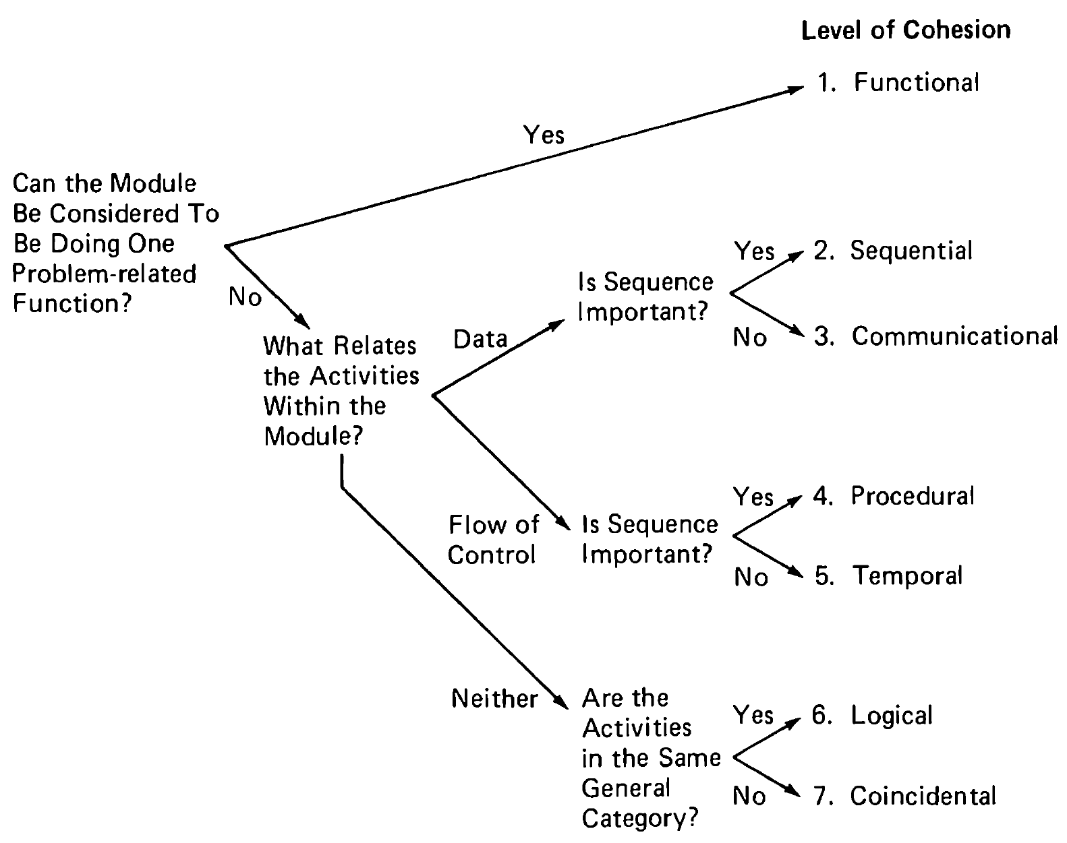
Determining Module Cohesion

Slide 50
The Structural Design Process [4]
The structural-design process follows the external-design process (specifying the external characteristics of the program or system) and precedes the module design processes (precisely defining the interface and logic of each module).
There are three steps in the structural design process:
Starting with the problem statement ( or functional or external specification), design the structure of the entire program or system using one or more forms of analysis.
Note that when designing a system ( a collection of related programs), an intermediate step is usually necessary. Before the system can be decomposed into modules, it must be decomposed into independent programs, or components.
Review the completed structural design, trying to maximize module strength and to minimize coupling.
Review the design again, using the guidelines ( decision structure, input/output isolation, restrictive modules, data access, size, recursion, predictable behavior) and the review process.
Note that this is an iterative process.

Slide 51
Composite Analysis
The basis of composite analysis is that the structure of the program should resemble the structure of the problem.
To accomplish this, composite analysis involves an analysis of the problem structure and, in particular, the flow of data through the problem and the transformations that occur on that data.
The rationale behind this is that problem structures are almost always defined in purely functional terms.
Consequently one way to arrive at a program structure with a functional organization (high module strength) is to model it after the problem structure.

Slide 52
Steps of Composite Analysis
The principal steps of composite analysis are:
Identify the problem structure.
Identify the principal input and output data streams in the problem.
Identify the points in the problem structure where these data streams begin and end.
Decompose this problem into a set of subordinate modules.
Repeat the process, viewing each module from step 4 as a new sub-problem.
Composite analysis is a top-down reasoning process. It involves iterating between defining sections of the program structure to supply functions and then generating new functional requirements from the completed sections of the structure.

Slide 53
Step 1: Problem Structure
The first step is sketching out a rough picture of the problem.
This sketch should be in functional, not procedural, terms.
(Procedural terms mean technical terms.)
Most, if not all, problems can be represented by a linear chain of three to ten processes.
The chain represents data flow within the problem, not necessarily the execution flow of the processes.
(Data flow means what constitute the processes.)
(Execution flow means how to implement the processes.)

Slide 54
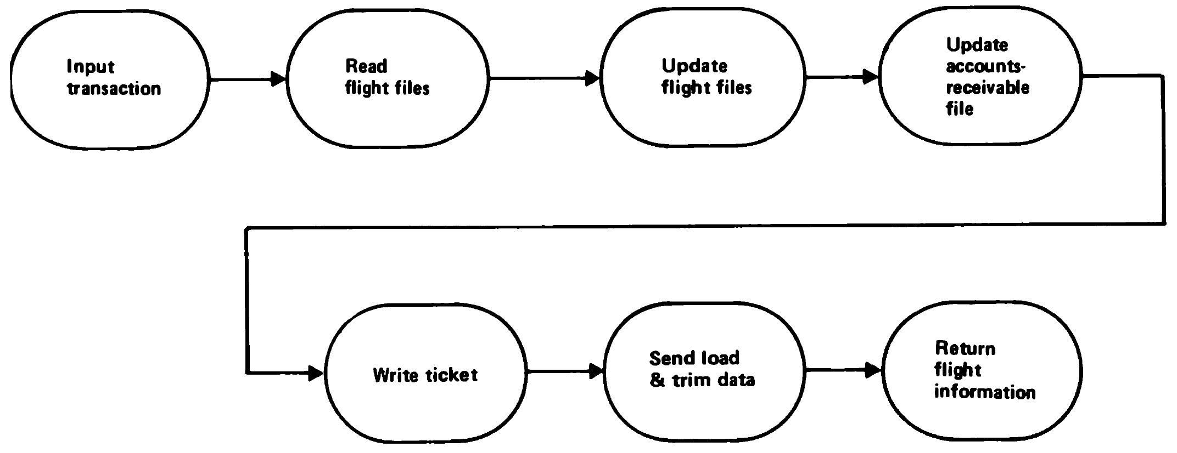
Problem Structure Example
As an example, consider a simple airlines reservation system.
It is driven by input from remote terminals.
The major types of input are requests for information (seats available, flights), sales of tickets, and passenger check-in’s.

Slide 55
Step 2: External Data Streams
Identify the streams of data that are both external and conceptual.
An external stream of data is one that begins and/ or ends outside of the system.
A conceptual stream of data is a stream of related data that is independent of any physical input-ouput device.
For instance, several conceptual streams may be coming from one input device or one stream may be coming from several input devices.

Slide 57
Further Reading
Larry Constantine and Edward Yourdon (1979). Structured Design: Fundamentals of a Discipline of Computer Program and Systems Design. Pearson.
Program Development by Stepwise Refinement (top down)
Structured Analysis and System Specification (data flow)
Structured Design: Fundamentals of a Discipline of Computer (data flow => modules)
Modern Structured Analysis (data flow => modules)
System Development (data structures)
Structured Systems Analysis and Structured Design
The JSP Design Process

Slide 58

Thank You & See You Again

